Slide 1
LogicGame
By tim farahani, max maier, marcel sommer

Slide 2
Agenda
Idea
Scope
Technology
Project Management
Demo
Architecture
Future

Slide 3

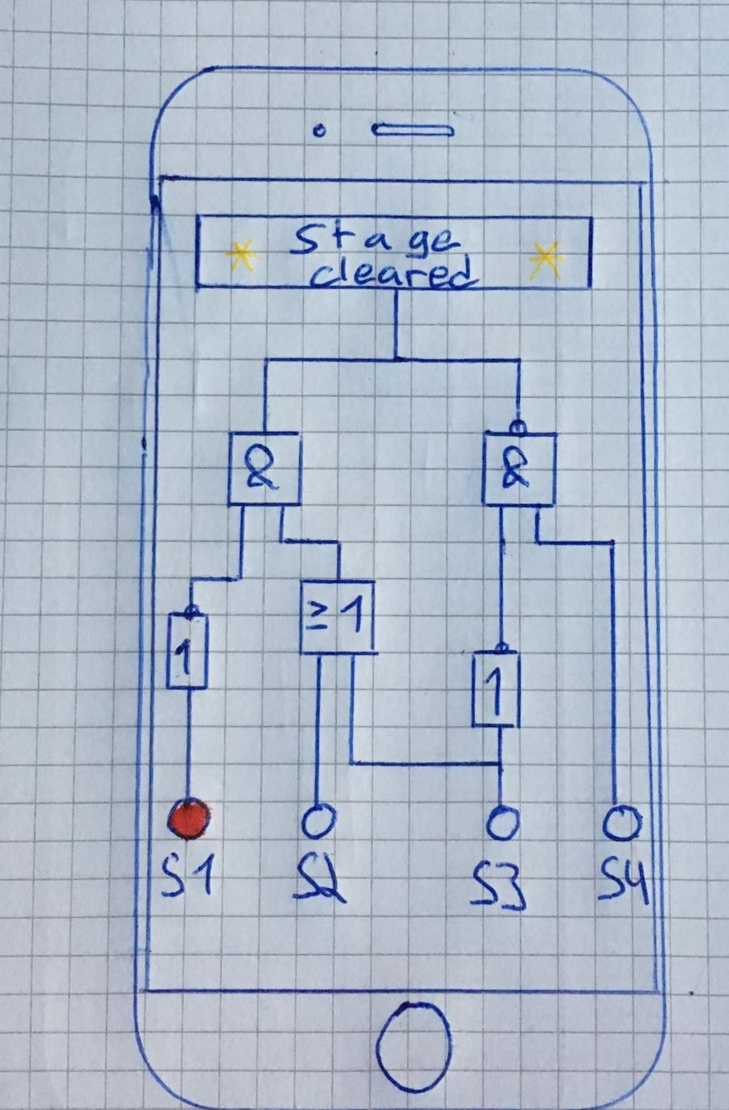
Idea
Smartphone game
Educational gaming
Easy to understand
Help players to understand logical gates
Deploy in schools
Lure pupils into technology

Slide 4
Scope
KISS – keep it simple (and) stupid
Level select screen
Play level screen
A few levels to play
Limited to the core:
No options
No special animations / videos
No registration
No advertisement

Slide 5
Software requirement specification
Document describes software requirements such as:
Functionality
Usability
Reliability
Performance
Supportability
Design Constraints
On-line User Documentation and Help System Requirements
Purchased Components
Interfaces
Licensing Requirements
Legal, Copyright, and Other Notices
Applicable Standards

Slide 6
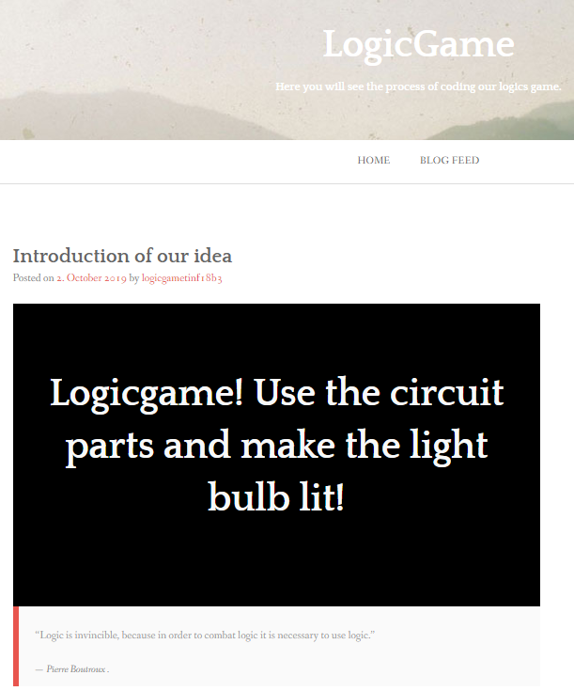




Blog
Notes:
Community, public

Slide 7
Technology

Slide 8
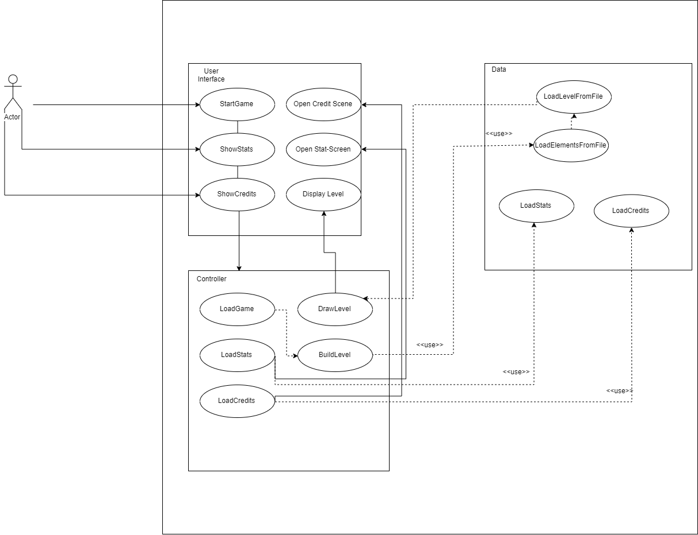
Overall use case diagram

Slide 9
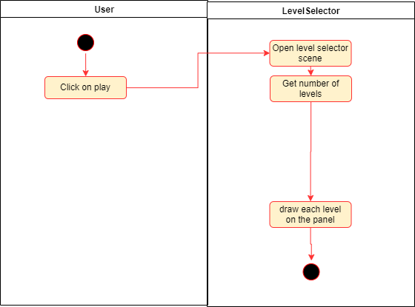
Use case LevelSelector
Notes:
Created use case specification dokuments

Slide 10
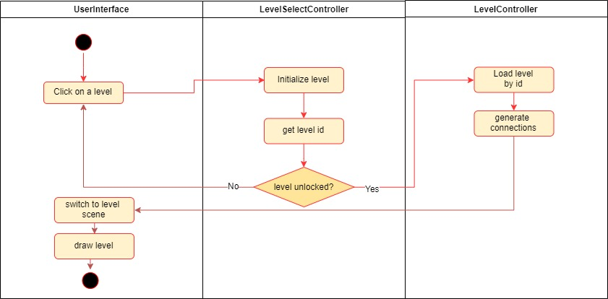
Use case load level

Slide 11

Use case draw level

Slide 12
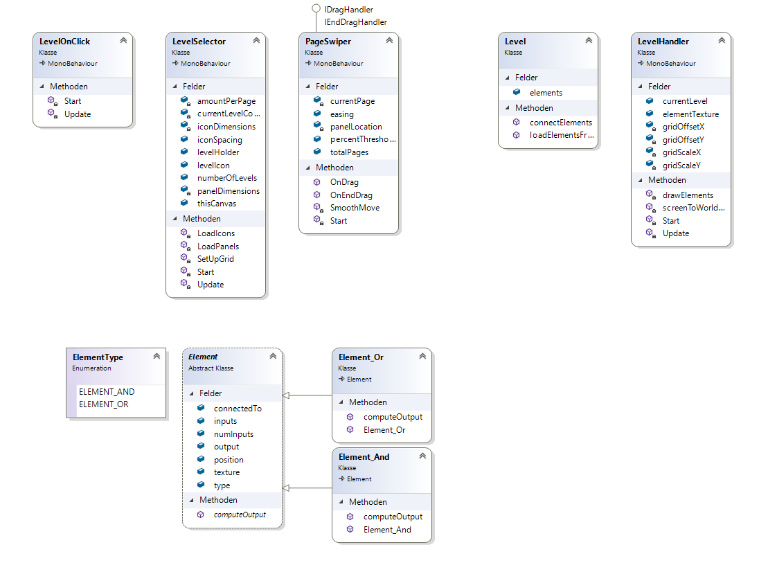
Class diagram

Slide 13
Unity
Game-Engine & Framework
Component-based programming
Easy & free to use
Huge community
Cross-Platform

Slide 14
Visual Studio Community 2019
IDE
Free for students
Syntax highlighting
Autocomplete
Plugins for Unity
Goes hand in hand with unity
C# compiler

Slide 15
Github
Development platform
Host and share code
Review options
Automatically distributed versions
Documentation
Accessible from everywhere & everyone

Slide 16
Tortoise git
Integration of github in a perfect and simple windows tool
Pull, push, diff, commit very quick and simple
UI for windows
Version control

Slide 17
Project Management

Slide 18
Scrum
Agile project management
Way more flexible than waterfall
Adjustable to costumer’s specification changes
Weekly Sprints → check and communicate with team members
Agile board as an overview
Showing partial result to inform costumer about the progress

Slide 19
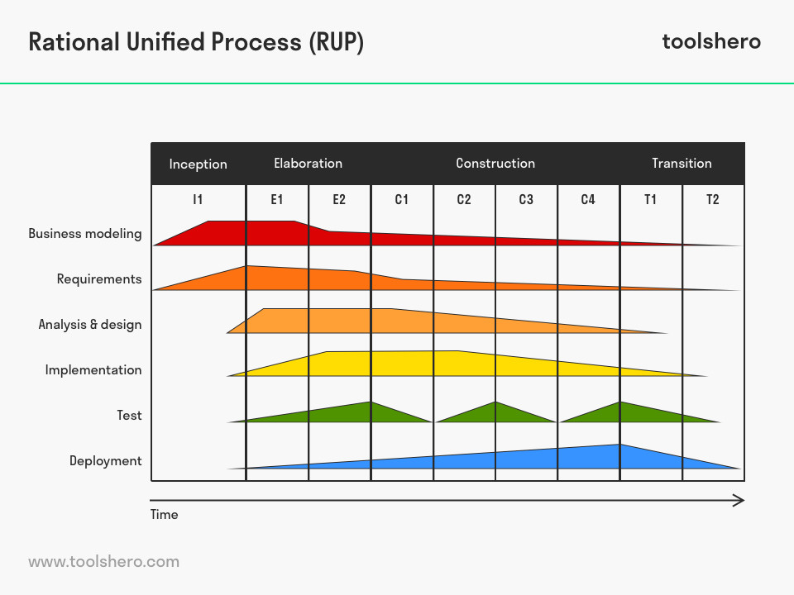
RUP

Slide 20
YouTrack
Free for students of DHBW
Issue list
Tracks Time spent
Integration with github
Different kind of reports
Coordinate tasks
Allows sharing content
Easy to use
Recommended

Slide 21
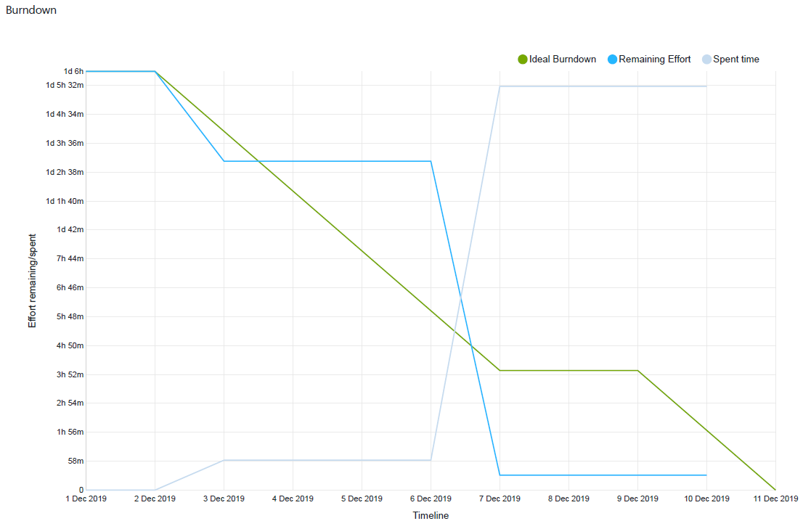
Burndown

Slide 22
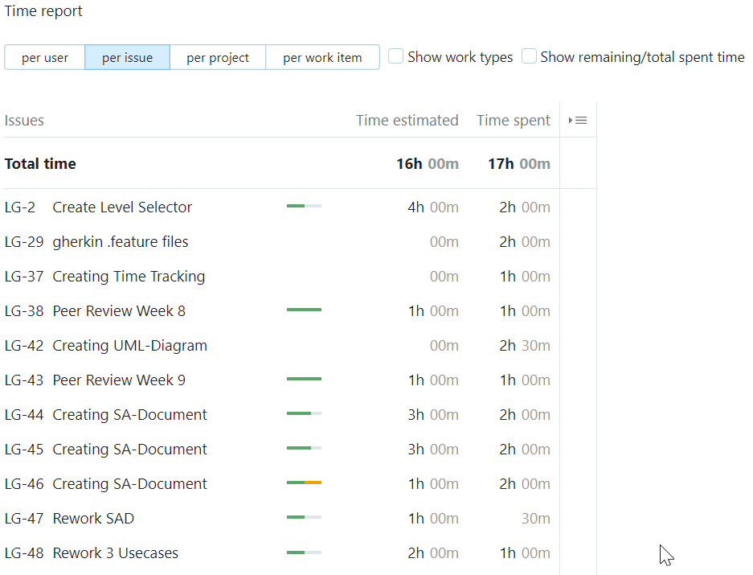
Time report

Slide 23
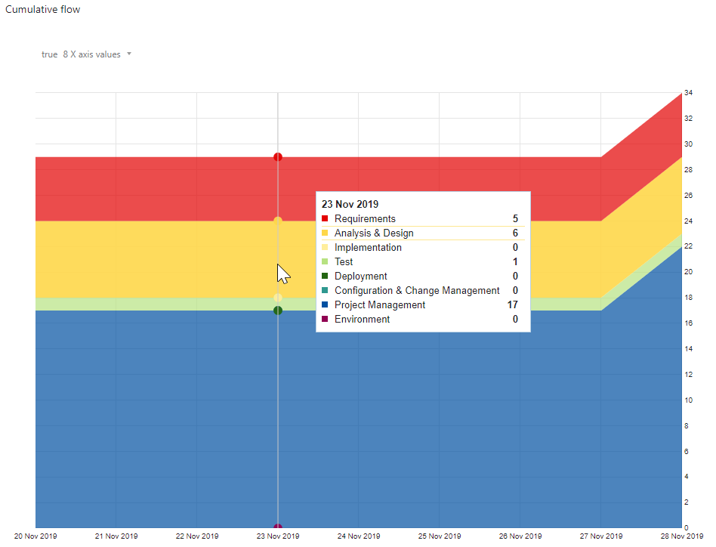
Cumulative flow project begin

Slide 24
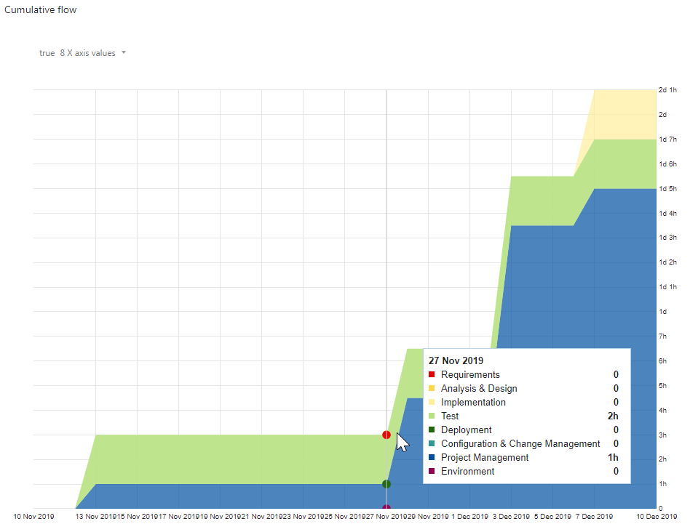
Cumulative flow project progress

Slide 25
Architecture

Slide 26
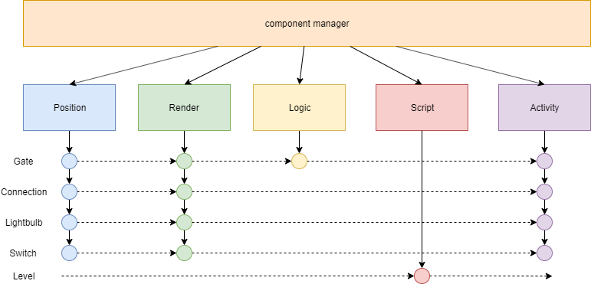
Component Architecture
Notes:
Software Architecture Document

Slide 27
Future / Possibilities
More levels → automatic level generator
Making money through advertisement
Pay for pro version to get it ad free
Registration required
Options menu

Slide 28
Demo

